Slide 1
Virtual Memory
15-213: Introduction to Computer Systems Recitation 10: Nov. 2, 2015
Karthic Palaniappan

Slide 2
Agenda
Shell Lab FAQs and I/O
Malloc Lab Preview
Virtual Memory Concepts
Address Translation
Basic
TLB
Multilevel

Slide 3
Updates
Shell Lab is due Tuesday (tomorrow), 11:59 p.m.
Malloc Lab is out Tuesday (tomorrow), 11:59 p.m.
Due Thursday, Nov. 19
Start early!!
“The total time you spend designing and debugging can easily eclipse the time you spend coding.”

Slide 4
Shell Lab FAQ
“The traces behave differently from command-line input!”
Some people are confused to find /bin/echo on their jobs list after running some trace files.
Some traces (e.g. trace05) print what they’re running before they run them. They do this by using /bin/echo.
So if you see a mysterious /bin/echo show up on your jobs list, you shouldn’t wonder why it got on your jobs list, you should wonder why it never got deleted.
Moral of the story: open the trace file and see what it does!

Slide 5
Shell Lab FAQ
Sigsuspend???
You can only use waitpid() once, but there are probably two places you probably need to reap children (one for foreground jobs, one for background jobs).
Temptation: use waitpid() for background jobs; use sleep() or a tight loop (i.e., while(1) {}).
Correct solution: use sigsuspend to block your process until a signal arrives.
int sigsuspend(const sigset_t *mask)
Temporarily replaces the process’s signal mask with mask, which should be the signals you don’t want to be interrupted by.
sigsuspend will return after an unblocked signal is received and its handler run. When it returns, it automatically reverts the process signal mask to its old value.

Slide 6
Shell Lab FAQ: sigsuspend example
int main() {
sigset_t waitmask, newmask, oldmask;
/* set waitmask with everything except SIGINT */
sigfillset(&waitmask);
sigdelset(&waitmask, SIGINT);
/* set newmask with only SIGINT */
sigemptyset(&newmask);
sigaddset(&newmask, SIGINT);
if (sigprocmask(SIG_BLOCK, &newmask, &oldmask) < 0) //oldmask now stores prev mask
unix_error("SIG_BLOCK error");
/* CRITICAL REGION OF CODE (SIGINT blocked) */
/* pause, allowing ONLY SIGINT */
if (sigsuspend(&waitmask) != -1)
unix_error("sigsuspend error");
/* RETURN FROM SIGSUSPEND (returns to signal state from before sigsuspend) */
/* Reset signal mask which unblocks SIGINT */
if (sigprocmask(SIG_SETMASK, &oldmask, NULL) < 0)
unix_error("SIG_SETMASK error");
}

Slide 7
System Calls and Error Handling
System Call Error Handling
Always handle errors for every system call – #include <errno.h>
Failed system calls almost always return -1
Global integer error number: errno
Getting error description: strerror(errno)
We deduct style points for not handling system call errors
Do not lose style points here!
Easy solution : Use wrappers from CSAPP website (Fork(),Execve(),Sigprocmask()…)

Slide 8
I/O Basics
Four basic operations:
open
close
read
write
What’s a file descriptor?
Returned by open.
int fd = open(“/path/to/file”, O_RDONLY);
fd is some positive value or -1 to denote error
Every process starts with 3 open file descriptors that can be accessed macros like STDOUT_FILENO
0 - STDIN
1 - STDOUT
2 - STDERR

Slide 9
How the Unix Kernel Represents Open Files
Two descriptors referencing two distinct open files. Descriptor 1 (stdout) points to terminal, and descriptor 4 points to open disk file
Descriptor table
[one table per process]
Open file table
[shared by all processes]
v-node table
[shared by all processes]
File A (terminal)
stdin
fd 0
File access
stdout
fd 1
File pos
File size
Info in
stat struct
stderr
fd 2
fd 3
refcnt=1
File type
fd 4
...
...
File B (disk)
File access
File pos
File size
refcnt=1
File type
...
...

Slide 10
File Sharing
Two distinct descriptors sharing the same disk file through two distinct open file table entries
E.g., Calling open twice with the same filename argument
Descriptor table
[one table per process]
Open file table
[shared by all processes]
v-node table
[shared by all processes]
File A (disk)
stdin
fd 0
File access
stdout
fd 1
File pos
File size
stderr
fd 2
fd 3
refcnt=1
File type
fd 4
...
...
File B (disk)
File pos
refcnt=1
...

Slide 11
How Processes Share Files: fork
A child process inherits its parent’s open files
Note: situation unchanged by exec functions (use fcntl to change)
Before fork call:
Descriptor table
[one table per process]
Open file table
[shared by all processes]
v-node table
[shared by all processes]
File A (terminal)
stdin
fd 0
File access
stdout
fd 1
File pos
File size
stderr
fd 2
fd 3
refcnt=1
File type
fd 4
...
...
File B (disk)
File access
File pos
File size
refcnt=1
File type
...
...

Slide 12
How Processes Share Files: fork
A child process inherits its parent’s open files
After fork:
Child’s table same as parent’s, and +1 to each refcnt
Descriptor table
[one table per process]
Open file table
[shared by all processes]
v-node table
[shared by all processes]
Parent
File A (terminal)
fd 0
File access
fd 1
File pos
File size
fd 2
File type
fd 3
refcnt=2
fd 4
...
...
Child
File B (disk)
File access
fd 0
File size
fd 1
File pos
fd 2
refcnt=2
File type
fd 3
...
fd 4
...

Slide 13
I/O Redirection
Question: How does a shell implement I/O redirection?
linux> ls > foo.txt
Answer: By calling the dup2(oldfd, newfd) function
Copies (per-process) descriptor table entry oldfd to entry newfd
Descriptor table
before dup2(4,1)
Descriptor table
after dup2(4,1)
fd 0
fd 0
fd 1
a
fd 1
b
fd 2
fd 2
fd 3
fd 3
fd 4
b
fd 4
b

Slide 14
I/O Redirection Example
Step #1: open file to which stdout should be redirected
Happens in child executing shell code, before exec
Descriptor table
[one table per process]
Open file table
[shared by all processes]
v-node table
[shared by all processes]
File A
stdin
fd 0
File access
stdout
fd 1
File pos
File size
stderr
fd 2
fd 3
refcnt=1
File type
fd 4
...
...
File B
File access
File pos
File size
refcnt=1
File type
...
...

Slide 15
I/O Redirection Example (cont.)
Step #2: call dup2(4,1)
cause fd=1 (stdout) to refer to disk file pointed at by fd=4
Descriptor table
[one table per process]
Open file table
[shared by all processes]
v-node table
[shared by all processes]
File A
stdin
fd 0
File access
stdout
fd 1
File pos
File size
stderr
fd 2
fd 3
refcnt=0
File type
fd 4
...
...
File B
File access
File pos
File size
refcnt=2
File type
...
...

Slide 16
Malloc Lab Sneak Preview
You will write your own dynamic storage allocator – i.e., your own malloc, free, realloc, calloc.
This week in class, you will learn about different ways to keep track of free and allocated blocks of memory.
Implicit linked list of blocks.
Explicit linked list of free blocks.
Segregated lists of different size free blocks.
Other design decisions:
How will you look for free blocks? (First fit, next fit, best fit…)
Should the linked lists be doubly linked?
When do you coalesce blocks?
This is exactly what you’ll do in this lab, so pay lots of attention in class. ☺

Slide 17
Malloc Lab Sneak Preview
If you haven’t been using version control so far, this is a good time to start.
Workflow:
Implement indirect linked lists. Make sure it works.
Implement explicit linked lists. Make sure it still works.
Implement segregated lists. Make sure it still works.
You WILL break things and need to revert.
Barebones guide to using git on the Shark Machines:
git init starts a local repository.
git add foo.c adds foo.c to that repository.
git commit -a –m ‘Describe changes here’ updates your repository with the current state of all files you’ve added.

Slide 18
Agenda
Shell Lab FAQs
Malloc Lab Sneak Preview
Virtual Memory Concepts
Address Translation
Basic
TLB
Multilevel

Slide 19
Virtual Memory Concepts
Memory
invisible to
user code
We’ve been viewing memory as a linear array.
But wait! If you’re running 5 processes with stacks at 0xC0000000, don’t their addresses conflict?
Nope! Each process has its own address space.
How???
Kernel virtual memory
0xC0000000
User stack
(created at runtime)
%esp
(stack
pointer)
Memory-mapped region for
shared libraries
0x40000000
brk
Run-time heap
(created by malloc)
Read/write segment
(.data, .bss)
Loaded from the executable file
Read-only segment
(.init, .text, .rodata)
0x08048000
Unused

Slide 20
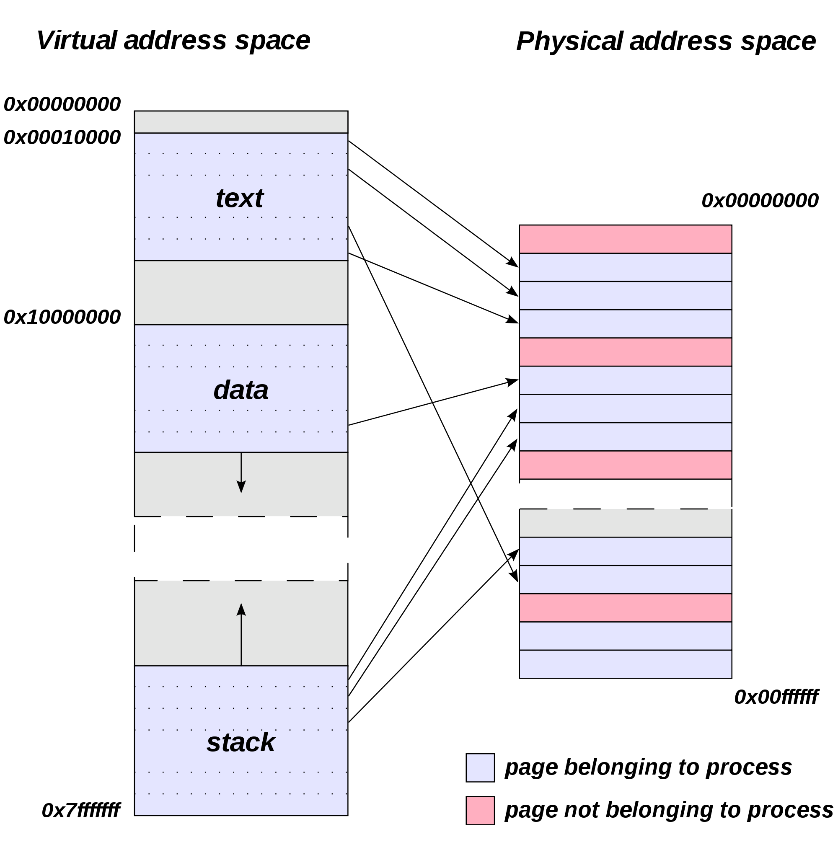
Virtual memory concepts
We define a mapping from the virtual address used by the process to the actual physical address of the data in memory.
Image: http://en.wikipedia.org/wiki/File:Virtual_address_space_and_physical_address_space_relationship.svg

Slide 21
Virtual memory concepts
This explains why two different processes can use the same address. It also lets them share data and protects their data from illegal accesses. Hooray for virtual memory!
0
Address
translation
0
Virtual Address Space for Process 1:
Physical
Address
Space (DRAM)
VP 1
VP 2
PP 2
...
N-1
PP 6
(e.g., read-only
library code)
Virtual Address Space for Process 2:
0
PP 8
VP 1
VP 2
...
...
N-1
M-1

Slide 22
Virtual memory concepts
Page table
Lets us look up the physical address corresponding to any virtual address. (Array of physical addresses, indexed by virtual address.)
TLB (Translation Lookaside Buffer)
A special tiny cache just for page table entries.
Speeds up translation.
Multi-level page tables
The address space is often sparse.
Use page directory to map large chunks of memory to a page table.
Mark large unmapped regions as non-present in page directory instead of storing page tables full of invalid entries.

Slide 23
Agenda
Shell Lab FAQs
Malloc Lab Sneak Preview
Virtual Memory Concepts
Address Translation
Basic
TLB
Multilevel

Slide 24
VM Address Translation
Virtual Address Space
V = {0, 1, …, N–1}
There are N possible virtual addresses.
Virtual addresses are n bits long; 2^{n} = N.
Physical Address Space
P = {0, 1, …, M–1}
There are M possible physical addresses.
Virtual addresses are m bits long; 2^{m} = M.
Memory is grouped into “pages.”
Page size is P bytes.
The address offset is p bytes; 2^{p} = P.
Since the virtual offset (VPO) and physical offset (PPO) are the same, the offset doesn’t need to be translated.

Slide 25
VM Address Translation
Virtual address
Page table base register
(PTBR)
n-1
p
p-1
0
Virtual page number (VPN)
Virtual page offset (VPO)
Page table address
for process
Page table
Valid
Physical page number (PPN)
Valid bit = 0:
page not in memory
(page fault)
m-1
p
p-1
0
Physical page number (PPN)
Physical page offset (PPO)
Physical address

Slide 26
VM Address Translation
Addressing
14-bit virtual addresses
12-bit physical address
Page size = 64 bytes
13
12
11
10
9
8
7
6
5
4
3
2
1
0
VPN
VPO
Virtual Page Number
Virtual Page Offset
11
10
9
8
7
6
5
4
3
2
1
0
PPN
PPO
Physical Page Number
Physical Page Offset

Slide 27
Example 1: Address Translation
Pages are 64 bytes. How many bits is the offset?
Find 0x03D4.
VPN: _____
PPN: ______
Physical address: ___________
13
12
11
10
9
8
7
6
5
4
3
2
1
0
VPN
VPO
VPN
PPN
Valid
VPN
PPN
Valid
00
28
1
08
13
1
01
–
0
09
17
1
02
33
1
0A
09
1
03
02
1
0B
–
0
04
–
0
0C
–
0
05
16
1
0D
2D
1
06
–
0
0E
11
1
07
–
0
0F
0D
1
PPN
PPO

Slide 28
Example 1: Address Translation
Pages are 64 bytes. How many bits is the offset?
Find 0x03D4.
VPN: _____
PPN: ______
Physical address: ___________
log₂ 64 = 6
13
12
11
10
9
8
7
6
5
4
3
2
1
0
0
0
0
0
1
1
1
1
0
1
0
1
0
0
VPN
VPO
VPN
PPN
Valid
VPN
PPN
Valid
0x0F
00
28
1
08
13
1
0x0D
01
–
0
09
17
1
02
33
1
0A
09
1
03
02
1
0B
–
0
0x0354
04
–
0
0C
–
0
05
16
1
0D
2D
1
06
–
0
0E
11
1
07
–
0
0F
0D
1
0
0
1
1
0
1
0
1
0
1
0
0
PPN
PPO

Slide 29
Agenda
Shell Lab FAQs
Malloc Lab Sneak Preview
Virtual Memory Concepts
Address Translation
Basic
TLB
Multilevel

Slide 30
VM Address Translation with TLB
That’s nice and simple, but it doubles memory usage.
One memory access to look in the page table.
One memory access of the actual memory we’re looking for.
Solution:
Cache the most frequently used page table entries in the TLB.
To look up a virtual address in the TLB, split up the VPN (not the whole virtual address!) into a TLB index and a TLB tag.
CPU Chip
TLB
2
PTE
VPN
3
Cache/
Memory
1
MMU
CPU
VA
PA
4
Data
5

Slide 31
Example 2: Address Translation with TLB
1 MB of virtual memory 4 KB page size
256 KB of physical memory TLB: 8 entries, 2-way set associative
How many bits are needed to represent the virtual address space?
How many bits are needed to represent the physical address space?
How many bits are needed to represent the offset?
How many bits are needed to represent VPN?
How many bits are in the TLB index?
How many bits are in the TLB tag?

Slide 32
Example 2: Address Translation with TLB
1 MB of virtual memory 4 KB page size
256 KB of physical memory TLB: 8 entries, 2-way set associative
How many bits are needed to represent the virtual address space?
How many bits are needed to represent the physical address space?
How many bits are needed to represent the offset?
How many bits are needed to represent VPN?
How many bits are in the TLB index?
How many bits are in the TLB tag?
20. (1 MB = 2²⁰ bytes.)
18. (256 KB = 2¹⁸ bytes.)
12. (4 KB = 2¹² bytes.)
8. (20-12.)
2. (4 sets = 2² set bits.)
6. (8-2.)

Slide 33
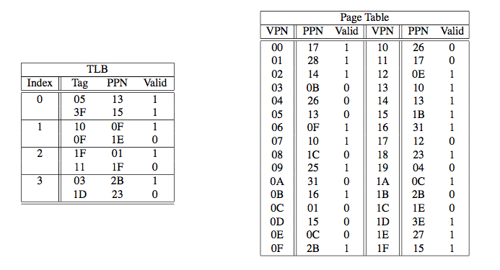
Example 2a: Address Translation with TLB
Translate 0x14213, given the contents of TLB and the first 32 entries of the page table below. (All the numbers are in hexadecimal.)

Slide 34
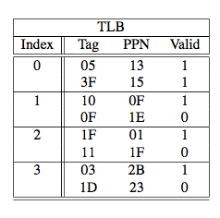
Example 2a: Address Translation with TLB
0x14213
19 | 18 | 17 | 16 | 15 | 14 | 13 | 12 | 11 | 10 | 9 | 8 | 7 | 6 | 5 | 4 | 3 | 2 | 1 | 0
VPN
VPO
VPN:
TLBI:
TLBT:
TLB Hit!
PPN:
Offset:
Physical address:

Slide 35
Example 2a: Address Translation with TLB
TLBT
TLBI
0x14213
19 | 18 | 17 | 16 | 15 | 14 | 13 | 12 | 11 | 10 | 9 | 8 | 7 | 6 | 5 | 4 | 3 | 2 | 1 | 0
0 | 0 | 0 | 1 | 0 | 1 | 0 | 0 | 0 | 0 | 1 | 0 | 0 | 0 | 0 | 1 | 0 | 0 | 1 | 1
VPN
VPO
VPN:
TLBI:
TLBT:
0x14
TLB Hit!
PPN: 0x13
Offset: 0x213
Physical address:
0x00
0x05
0x13213

Slide 36
Example 2b: Address Translation with TLB
Translate 0x1F213, given the contents of TLB and the first 32 entries of the page table below.

Slide 37
Example 2b: Address Translation with TLB
0x1F213
19 | 18 | 17 | 16 | 15 | 14 | 13 | 12 | 11 | 10 | 9 | 8 | 7 | 6 | 5 | 4 | 3 | 2 | 1 | 0
VPN
VPO
VPN:
TLBI:
TLBT:

Slide 38
Example 2b: Address Translation with TLB
TLBT
TLBI
0x1F213
19 | 18 | 17 | 16 | 15 | 14 | 13 | 12 | 11 | 10 | 9 | 8 | 7 | 6 | 5 | 4 | 3 | 2 | 1 | 0
0 | 0 | 0 | 1 | 1 | 1 | 1 | 1 | 0 | 0 | 1 | 0 | 0 | 0 | 0 | 1 | 0 | 0 | 1 | 1
VPN
VPO
VPN:
TLBI:
TLBT:
0x1F
TLB Miss!
Step 2: look it up in the page table. ☹
0x03
0x07

Slide 39
Example 2b: Address Translation with TLB
TLBT
TLBI
0x1F213
19 | 18 | 17 | 16 | 15 | 14 | 13 | 12 | 11 | 10 | 9 | 8 | 7 | 6 | 5 | 4 | 3 | 2 | 1 | 0
0 | 0 | 0 | 1 | 1 | 1 | 1 | 1 | 0 | 0 | 1 | 0 | 0 | 0 | 0 | 1 | 0 | 0 | 1 | 1
VPN
VPO
VPN:
TLBI:
TLBT:
0x1F
Page Table Hit
PPN:
Offset:
Physical address:
0x03
0x07

Slide 40
Example 2b: Address Translation with TLB
TLBT
TLBI
0x1F213
19 | 18 | 17 | 16 | 15 | 14 | 13 | 12 | 11 | 10 | 9 | 8 | 7 | 6 | 5 | 4 | 3 | 2 | 1 | 0
0 | 0 | 0 | 1 | 1 | 1 | 1 | 1 | 0 | 0 | 1 | 0 | 0 | 0 | 0 | 1 | 0 | 0 | 1 | 1
VPN
VPO
VPN:
TLBI:
TLBT:
0x1F
Page Table Hit
PPN: 0x15
Offset: 0x213
Physical address:
0x03
0x07
0x15213

Slide 41
Agenda
Shell Lab FAQs and I/O
Malloc Lab Sneak Preview
Virtual Memory Concepts
Address Translation
Basic
TLB
Multilevel

Slide 42
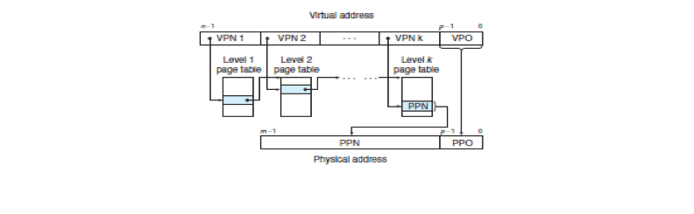
Address Translation in Real Life
Multi level page tables, with the first level often called a “page directory”
Use first part of the VPN to get to the right directory and then the next part to get the PPN
K-level page table divides VPN into k parts

